Slide 1


Embedding Human Factors in Healthcare: Benefits, Progress and Challenges
Paul Bowie
PhD C.ErgHF, MCIEHF FRCPEd FRCGP (hon)
Notes:
HIDDEN SLIDE
Notes on Design of PowerPoint Slides
The Brilliant Basics slide decks provided are on blank PowerPoint templates. We did not wish to design them using our organisational design guidance and our own customised slides decks. We think it is better if we leave them blank so that you can customise them locally to fit with your own corporate design guidance with your own logo etc
PLEASE ACKNOWLEDGE THE SOURCE OF BRILLIANT BASIC TEACHING PACKS ON YOUR OWN SLIDE DECKS:
NHS Education for Scotland
University of Aberdeen
University of Staffordshire
THANK YOU
Talking Points:
Discussion/Activity Questions:
Time Allocations:
Visual Cues:
Technical Notes:
Contingency Plans:

Slide 2

Big Idea
Explore our understanding of Human Factors
Benefits e.g.
  Safety learning reviews
  Culture
  Education and training
Challenges e.g.
  Policy
  Education
  National initiatives
Q&A

Slide 3
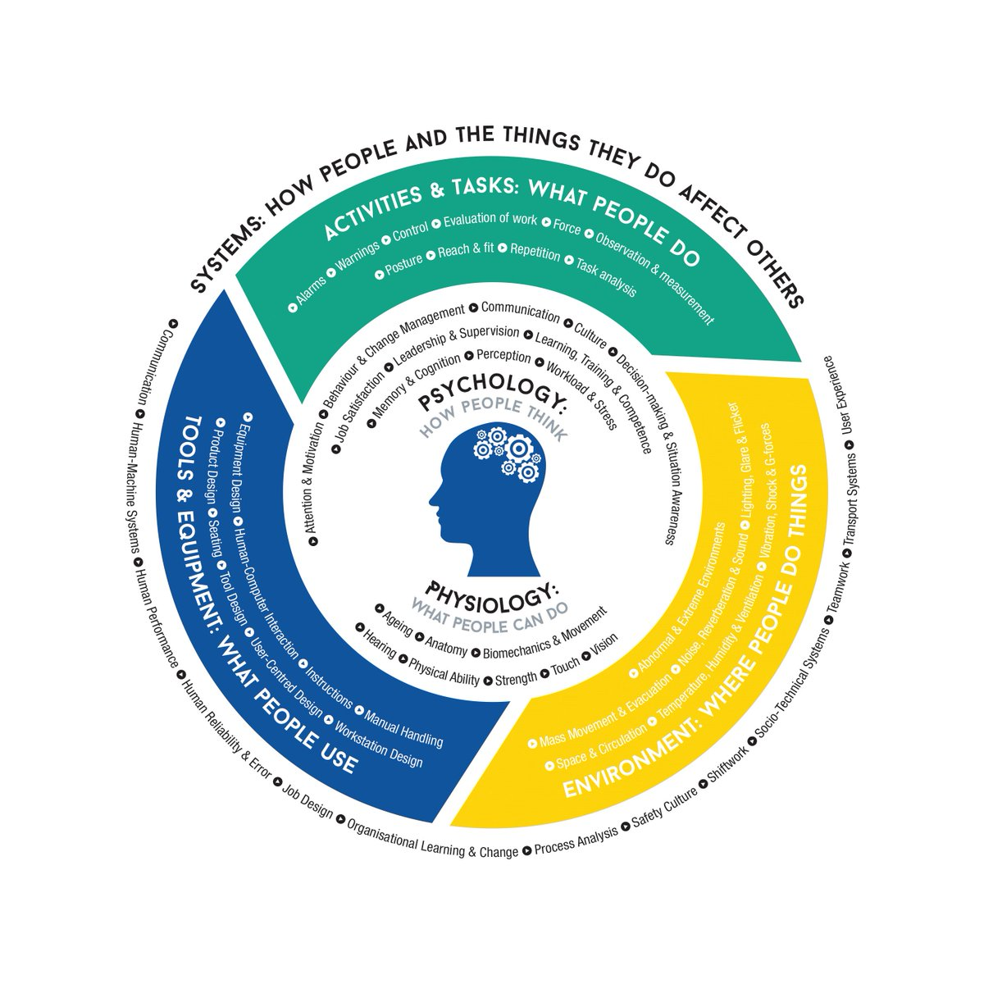
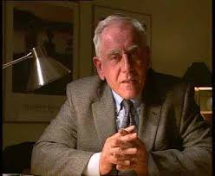
Designing for people to make things easier, efficient, safer, usable, useful, comfortable, enjoyable…
“We cannot change the human condition, but we can change the conditions under which humans work”
[Reason, 1997]
Notes:
Talking Point: This slide highlights that HFE is not a behavioural science as many people might assume but that it is a systems and design-based discipline. So unlike psychologists or even educators we’re not trying to ‘get inside your head’ to change you, but instead we’re trying to change/design the conditions under which you work to make things easier, efficient and safer.
Discussion Question:
Activity:
Time:
Approx 2 minutes
Visual Cue:
The photo is of the late Professor James Reason, a world renowned psychologist and author, famous for this research on ‘human error’ and for designing the Swiss Cheese metaphor and who is well known for this quote which perfectly sums up the HFE approach.

Slide 4
Focus is on improving all aspects of Human Work e.g.
New digital information technology
Reducing work-related musculoskeletal disorders
New ways of working e.g. AI
Healthcare procurement of products & services
Tasks, processes & work systems
Reflecting on prevailing safety culture
Medical device design & usability
Design of care environments / buildings
Design & usability of incident reporting systems
Wellbeing - job stress, fatigue and burnout
Safety & Improvement interventions
Learning from events & everyday work
Known sources of design failures, risks and harms!
Notes:
Talking Point: This slide highlights that HFE is concerned with improving all aspects of human work in healthcare – these are examples of areas where HFE has been active in healthcare. Unfortunately, much this work is research-related rather than being a focus of routine operational activity, largely because HFE is not that well known at the policy/regulation levels and also because of the very limited number of HFE specialists in employment in healthcare.
Discussion Question: Highlight 1 or 2 of the boxes and again ask Learners to share their own experiences of design failures or risks related to these areas.
Activity:
Time:
Approx 2-5 minutes
Visual Cue:

Slide 5
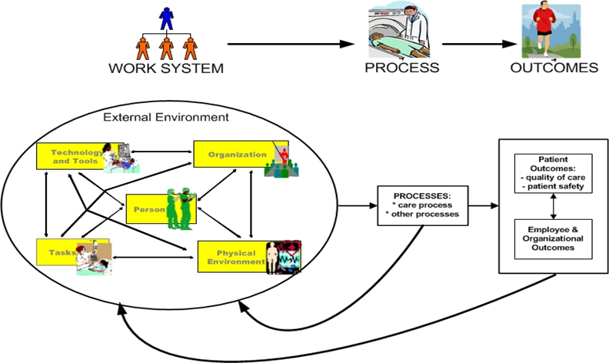
Human Factors is Systems-Focused…
System Engineering Initiative for Patient Safety (SEIPS) Framework (Carayon et al, 2006)
Notes:
Talking Points: This is SEIPS (pronounced SEEPS) or the Systems Engineering Initiative for Patient Safety which is arguably the most well-known and well used HFE approach in healthcare. Over the previous years SEIPS has evolved into three different (1.0, 2.0, 3.0) but overlapping frameworks, this is the first one and the easiest to understand and engage with.
So, this image depicts a generic work system in any healthcare setting (e.g. community pharmacy, outpatient clinic, operating theatre, surgical ward, family practice office) and is a perfect illustration of the HFE “systems approach”.
The focus of the care work system on the left of the diagram is on characterising the interactions between people and five other system elements or components: job tasks, tools and technology, the physical environment, organisational of work, and external influences such as safety legislation, regulation and policy. A fuller description of the performance influence factors related to each of these work system elements that can enhance or degrade performance and wellbeing is also illustrated in the worksheet tool which will be introduced in this session.
It is important to note that it is the complex interactions and inter-dependencies between these system elements that combine to create both wanted and unwanted outcomes related to overall work system performance and human wellbeing, outlined on the right side of the diagram. The framework acknowledges that work systems and processes are dynamic and constantly adapt (illustrated by the arrows as feedback loops) and, critically, that from related work system (sometimes unpredictable) interactions, both wanted and unwanted outcomes emerge. Integrated within, and aligned with all aspects of the SEIPS framework, is Donabedian’s well established conceptual model that provides a structure-process-outcomes (SPO) framework for understanding, examining, and evaluating the quality of healthcare delivery [
For information, SEIPS is incorporated into patient safety incident investigation practices in England and for reflecting on and analysing events in Mortality and Morbidity/Learning from Events meetings in Scotland
Discussion Question: Ask Learners if they’re aware of the is framework or have any experience of it?
Activity:
Time:
Approx 10 minutes
Visual Cue: Highlight the complex interactions between the different work system elements and how these influence outcomes (wanted and unwanted) on the right side of the image – this illustrates the concept of ‘emergence’ – this is a known attribute of a high complex work system like much of healthcare. Outcomes (e.g. workforce wellbeing, patient safety and so on) emerge out of these interactions some of which may not be predicted or on a specific day were not an issue but on another day interacted slightly differently to contribute to an unwanted outcome

Slide 6
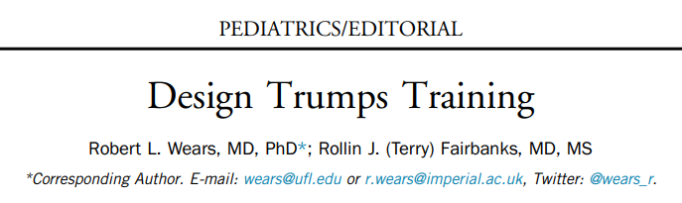

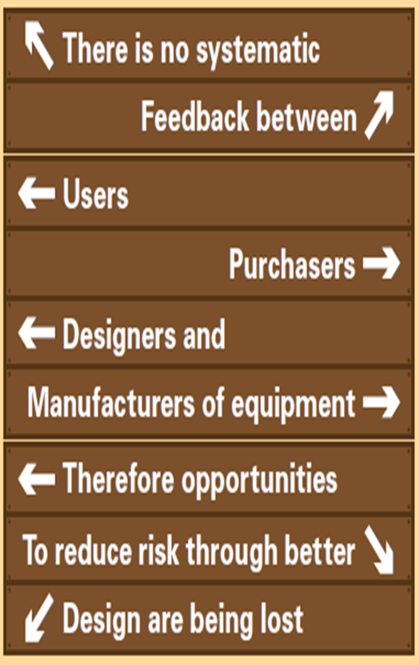

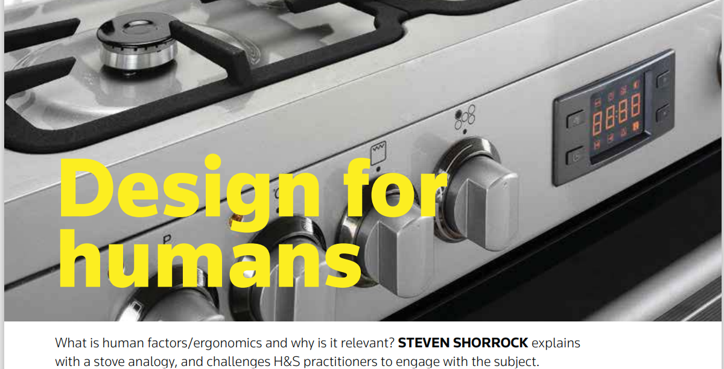

Human Factors is Design-Focused…

Slide 7
THE Mothership Slide
Distinguishing Features of Human Factors & Ergonomics
It ALWAYS takes a Systems Approach (holistic)
It is ALWAYS Design Driven (to take account of human characteristics, needs, capabilities and preferences)
It focuses ALWAYS on two closely related outcomes: System Performance and Human Well-being
(“Twin Aims” = “Joint Optimisation”)
Notes:
Talking Points: This is THE Mothership slide – everything comes back to these three distinguishing features of HFE that uniquely set it apart from other disciplines and approaches. Realistically, if a HFE project/study does not take a systems approach AND has a design intext AND focuses on improving BOTH performance and wellbeing then technically it is not HFE (even if it is very good) – unfortunately, much of what is published about HFE in healthcare fails to adhere to these distinguishing features. For Learners, being aware of these (especially the Twin Aims of HFE) and thinking about them in any aspect of their work (whether reflecting on events or designing new approaches) will add value to these activities.
We will unpack each in more detail in the coming slides
Discussion Question: Optional – Ask Learners what they understand by a ‘systems approach’?
Activity:
Time:
Approx 5-10 minutes
Visual Cue:

Slide 8


Benefits and Progress

Slide 9
Board Members and Senior Executive Teams
10 Human Factors Priorities for Active Governance
1. Digital IT Systems
6. Organisational Safety Systems
2. Workforce Wellbeing
7. Safety Culture
3. Built Environment
8. Quality Improvement
4. Procurement
9. Building Capacity & Capability
5. Medical Devices
10. Organisational Changes

Slide 10

Examples of Human Factors Integration in
Education and Training
Entry-level HFE e-learning
Open Access CPD Module
HFE Primer for Academics, Educators and Learners
Safety Learning Reviews (Team and Organisational Level)
Brilliant Basics HFE Teaching Packs (Phase 1)

Slide 11
Brilliant Basics HFE Teaching Packs – Phase 1
Introduction to HFE
The Systems Approach
Designing for People
Exploring Human Work
Designing Work Procedures
Safety
Culture
Building Local Capacity & Capability
HFE Principles for Transformative Simulation
Task Analysis
Link Analysis
BowTie Analysis
Dynamic Risk Assessment
Interface Design Tool
Physical Environment
Usability Evaluation
Systems Thinking Principles
HFE Principles for Quality
Improvement
Systems Thinking Principles

Slide 12


Integration with Quality Improvement
Systems Thinking Principles
SEIPS
WTTT
Resilience Engineering

Slide 13



Participatory Design of Safety Checklists

Slide 14

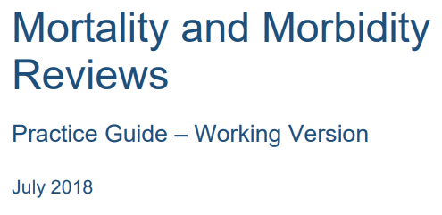

Team and Organisational Safety Learning Reviews

Slide 15
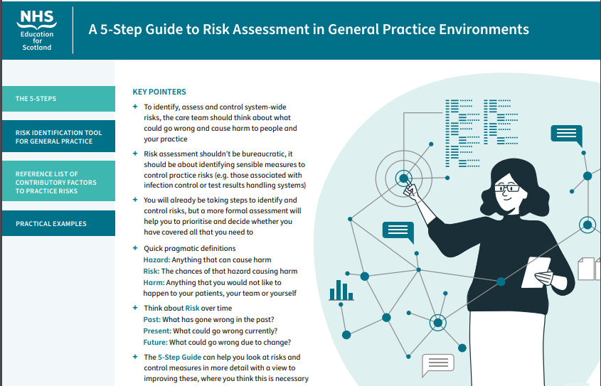

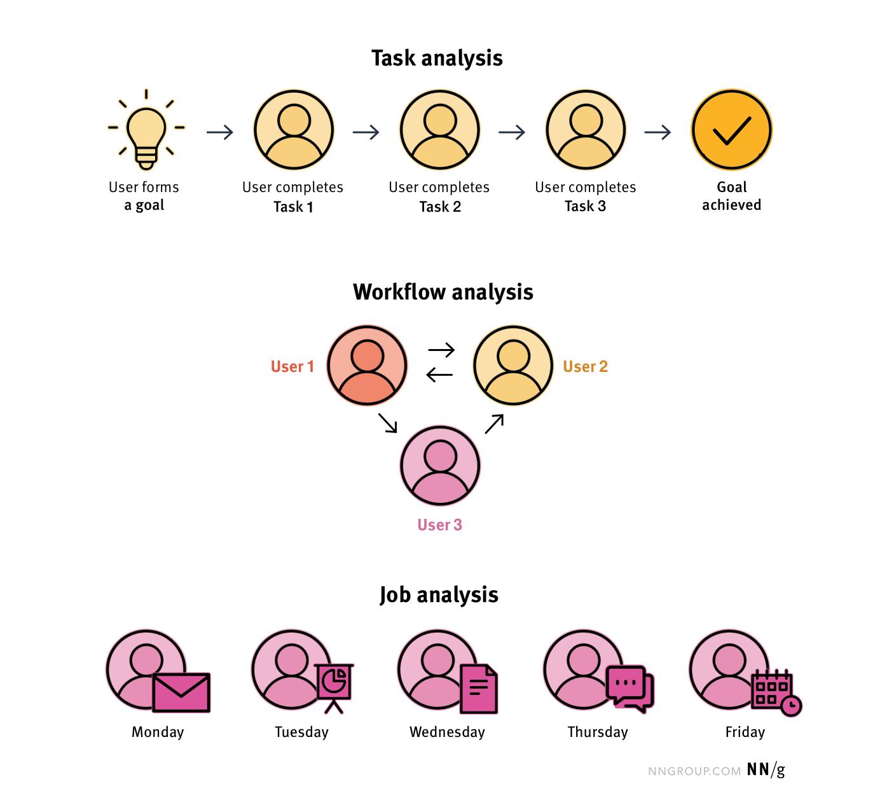
Proactive Risk Assessment
WALK-THROUGH TALK-THROUGH

Slide 16
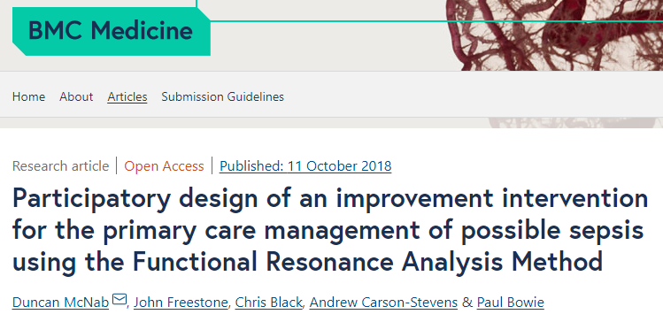

Understanding Complex System Performance

Slide 17



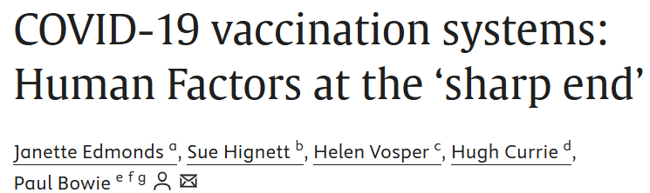
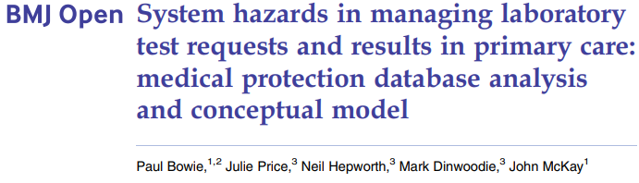
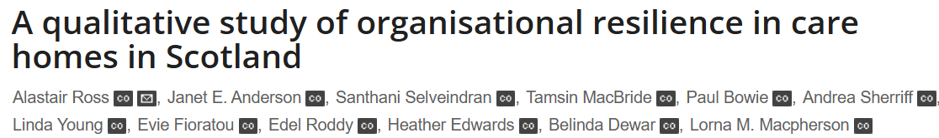
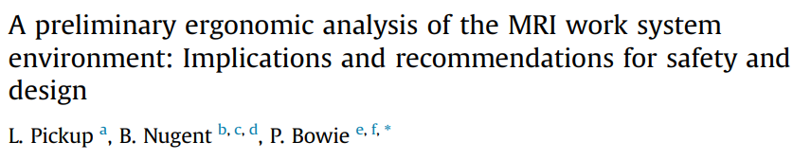
Exploring Complex System Safety

Slide 18


Care System Analysis Tool (CSAT)
Work System Design Issues (e.g. Facilitators or Barriers)
Care Process
Outcomes
External Influences
What Care Task or Process is Being Performed?
Wanted / Unwanted
Outcomes
System Performance:
Human Wellbeing:
Technology and Tools
Organisation of Work
Person Factors
Job Tasks
Physical Environment
Notes:
Hello

Slide 19
CSAT Explained
Examples of Interacting System Elements
Outcomes
The tool is based on the SEIPS (System Engineering Initiative for Patient Safety) Framework.
This is a Human Factors systems approach to understanding care processes, work systems and outcomes to inform better design and improvement.
The Tool can be used by anyone as a general systems analysis and problem-solving tool e.g. safety learning reviews; hazard identification; design of incident reporting & data collection; simulation design; protocol & checklist development; research design and data analysis.
Person Factors
e.g. Physical, psychological capabilities, limitations and impacts (frustration, stress, fatigue, burnout, musculoskeletal, satisfaction, enjoyment, experiences, job control); personality or social issues; cognitive ; competence, skills, knowledge, attitudes; risk perception; training issues; personal needs and preferences; psychological safety; performance variability; personal goals; adaptation to work conditions.
Care team e.g. roles, support, communication, collaboration, supervision, management, leadership
Patient/client e.g. complexity of clinical condition, physical, social, psychological, relationship factors
Others e.g. families and carers, and other health and social services colleagues
Task Factors
Specific actions within larger work processes, includes task attributes such as:
level of task difficulty /complexity;
time taken;
hazardous nature;
variety of tasks;
sequencing of tasks
workload, time pressure, cognitive load,
Organisation of Work Factors
e.g. Structures external to a person (but often put in place by people) that organise time, space, resources, and activity.
Within institutions:
Work schedules/staffing
Workload assignment
Management and incentive systems
Organisational / safety culture (values, commitment, transparency)
Training
Policies/procedures
Resource availability and recruitment
In other settings:
Communication
Infrastructure
Living arrangements
Family roles and responsibilities
Work and life schedules
Financial and health-related resources
Outcomes –
System Performance
e.g. Safety; productivity; resilience; efficiency; effectiveness; care quality
Physical Environment
e.g. Layout; noise; lighting; vibration; temperature; humidity and air quality; design of immediate workspace or physical environment layout; location; size; clutter; cleanliness; standardisation, aesthetics; crowding
Outcomes –
Human Wellbeing
e.g. Health and safety; patient satisfaction and experience; enjoyment; staff turnover; staff welfare; job satisfaction
Guiding Step
As a team, use the CSAT worksheet as a prompt to highlight the system-wide factors that contribute to the issue at hand
Seek to understand how these factors influence processes and interact to produce outcomes (both wanted or unwanted)
Link this new knowledge to making work system redesign or improvement recommendations
External Influences
e.g. Societal, government, cultural, accreditation and regulatory influences e.g. funding, national policies and targets, professional bodies, regulatory demands, legislation and legal influences, other risks and influences
Tools & Technology
e.g. design interaction and device usability issues; familiarity; positioning, accessibility; availability; access; mobility; operational /calibrated /maintained; device usability; various IT design issues.

Slide 20
Patient Safety Fallacies
The Myth of the Safe Care System
The Myth of Zero Harm (‘Never Events’)
The Myth of Linear Determinism
The Myth of Standardisation and Controlling Variation
The Myth of Reliable Care Processes
The Myth of ‘Medical Error’
The Myth of the ‘Hero’
K Catchpole, P Bowie, S Fouquet et al (2021)

Slide 21
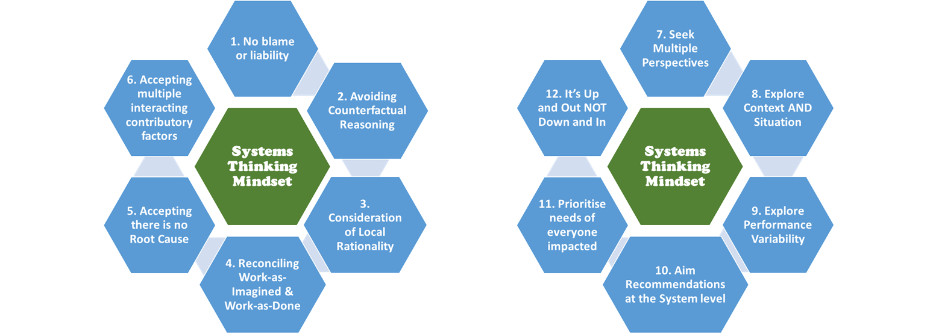
Systems Thinking Principles
Notes:
Ask group to reflect on these principles. Which ones are familiar? What is new to you and needs to be unpacked? Where are you in terms on integrating these in organisational policy, education and practice? How feasible is this?
See Crib Sheet for detailed explanation of each principle.

Slide 22
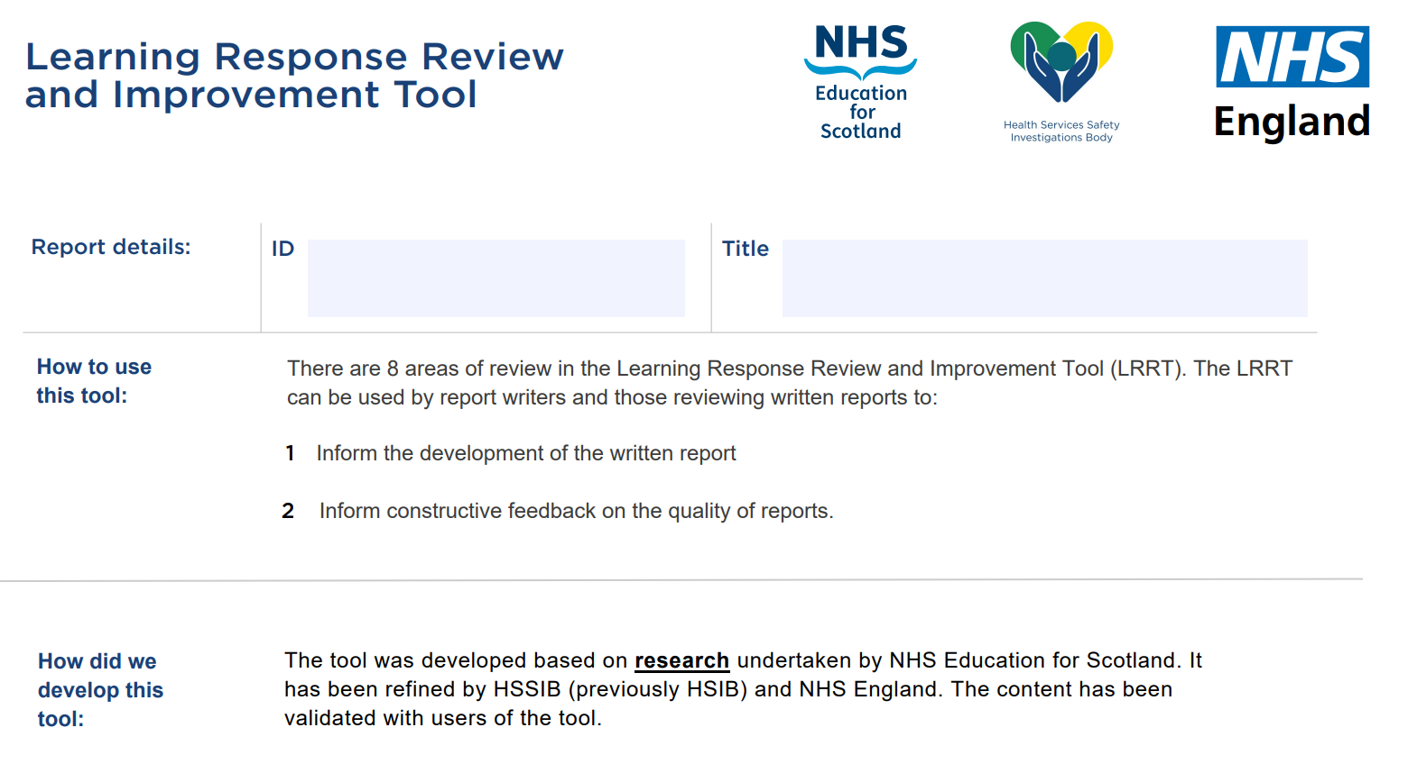
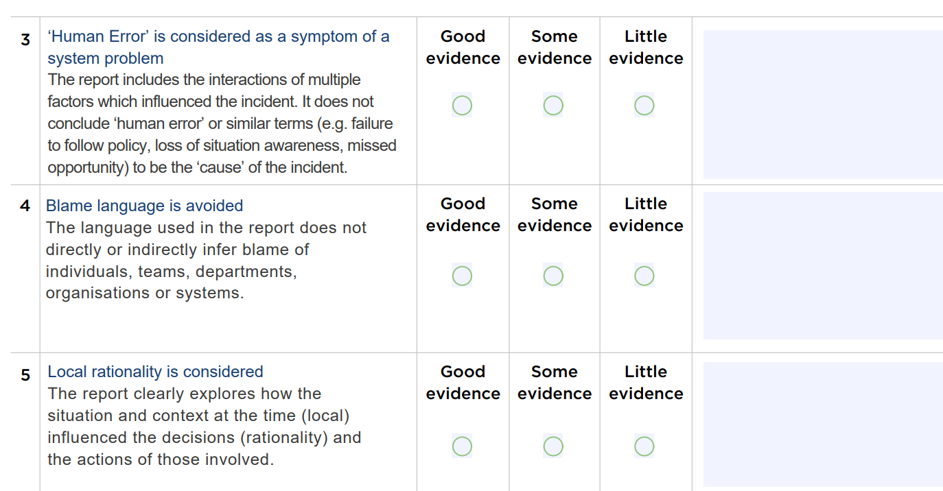
Learning Response Review Tool

Slide 23
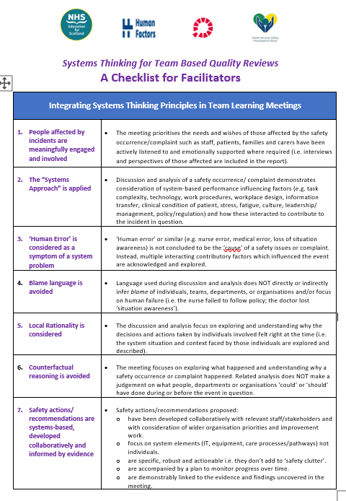
Guiding Systems-Focused Discussions in Team Meetings

Slide 24


Safety Culture Discussion Cards

Slide 25

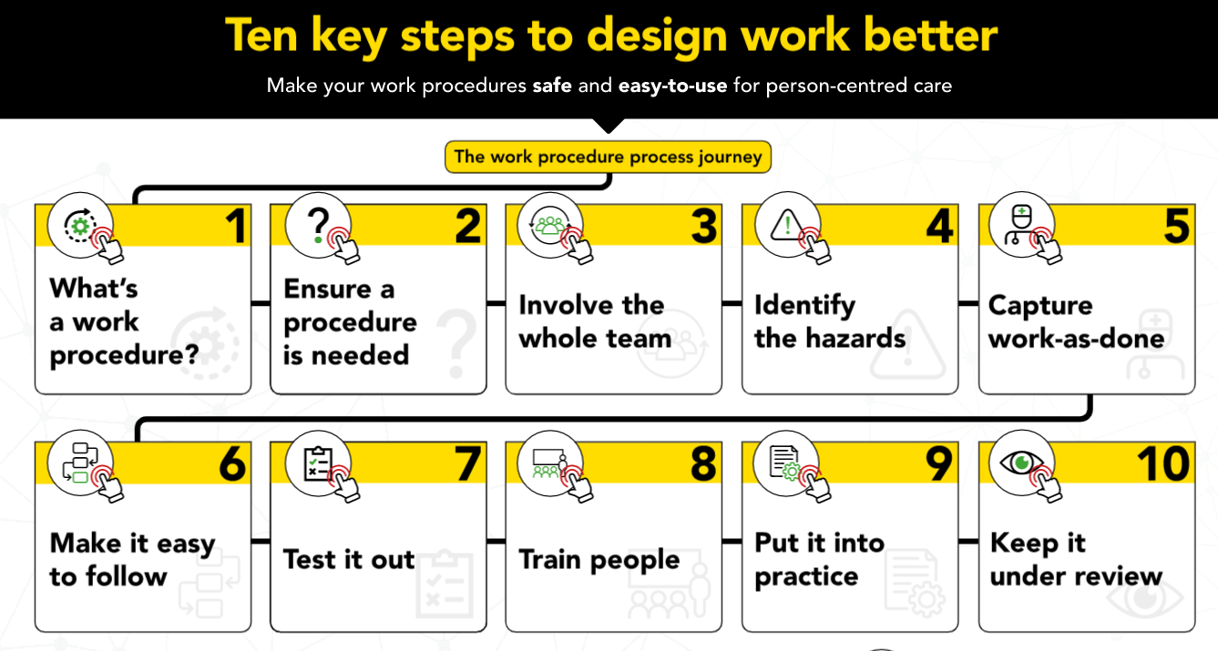
Human-Centred Design of Work Procedures

Slide 26
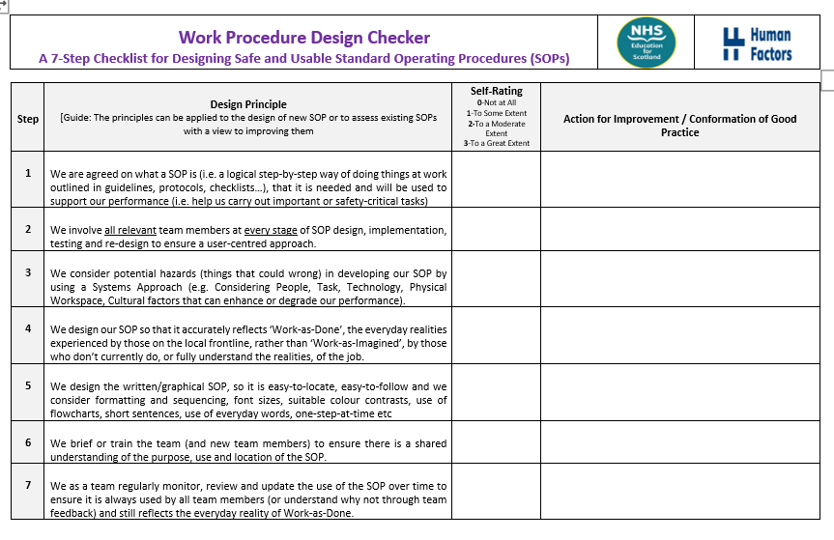
Work Procedures Design Checker
Notes:
Facilitator Guidance script:
Talking Points: If time is available, then briefly introduce the is tool which is based on the guiding principles – it can be used to ‘audit’ the extent to which existing work procedures align with good practices and where necessary identify areas for improvement.
Discussion/Activity Questions:
Time Allocations:
Visual Cues:
Technical Notes:
Contingency Plans:

Slide 27
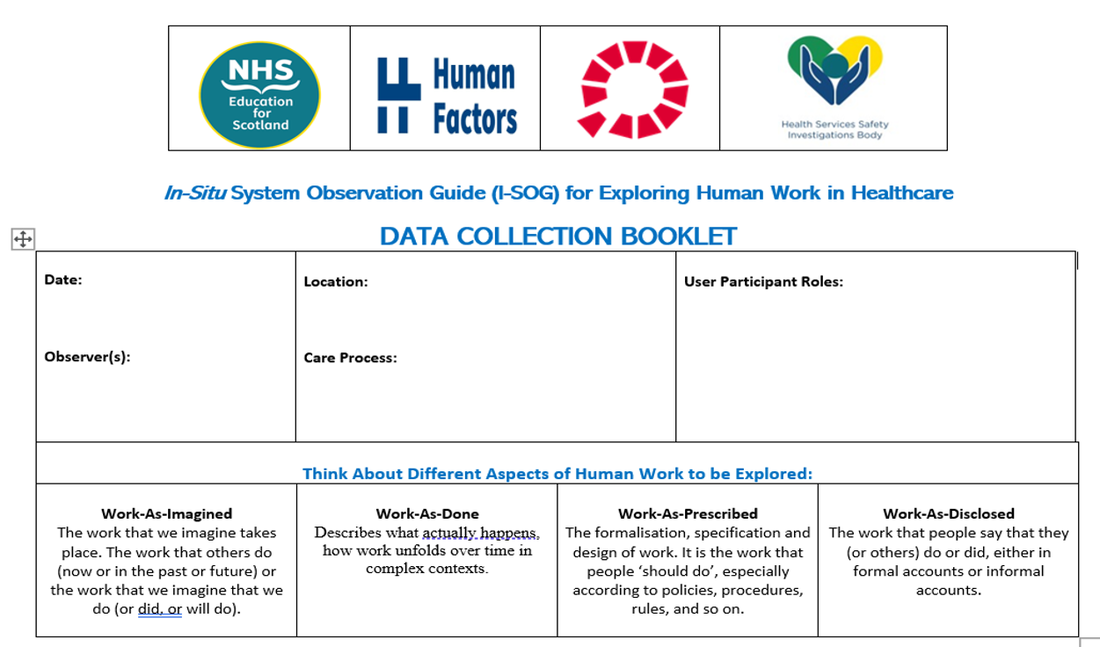
Exploring and Capturing the Complexity of Everyday Work

Slide 28




Systems Safety Challenge Cards

Slide 29

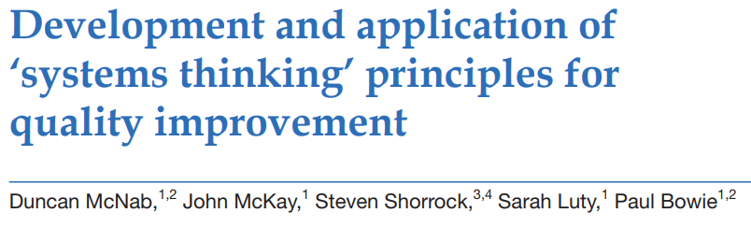
Systems Thinking for QI

Slide 30
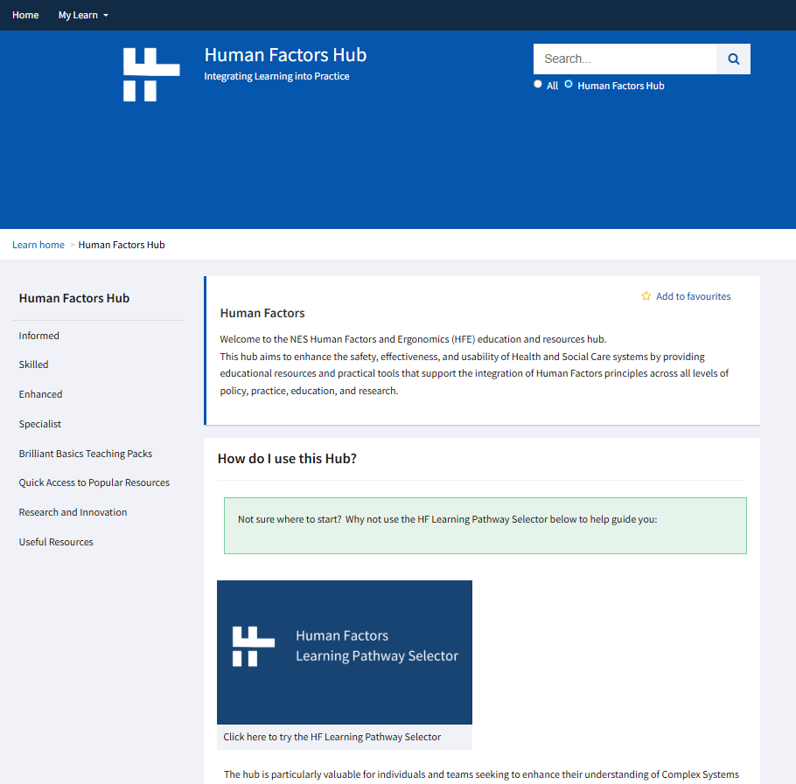

Online HFE Hub Development

Slide 31

So, Good Progress…
But Ongoing Challenges

Slide 32

Limited HF Knowledge in the Healthcare Community

Slide 33
Other High-Risk Industries
Human factors is a scientific discipline, with scientific methods, highly established in other safety critical industries:
  Nuclear
  Maritime
  Military
  Aviation
  Rail
  Surveillance
  Offshore industries
  Energy
Aviation versus Healthcare Comparison!!!
EUROCONTROL c7500 employees (40 professionals)
UK Health Service c1.3m employees (<10 professionals)
Urgent need to build capacity & capability
Notes:
Talking Point: This slide highlights that HFE is well established in many other safety-critical sectors globally, but not yet in healthcare, paradoxically the most complex and safety-critical human work endeavour to ever exist.
Discussion Question:
Activity:
Time:
Approx 2 minutes
Visual Cue:
Highlight the stark comparison between healthcare and air traffic control in terms of the number of HFE professionals employed to support safety-critical work in both industries.

Slide 34
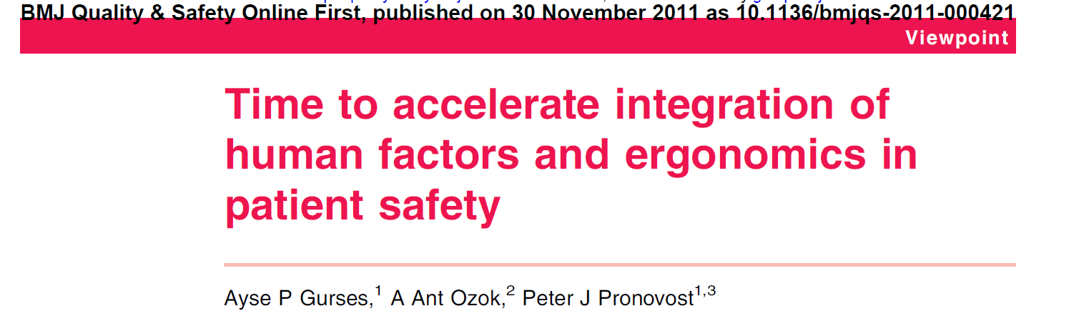
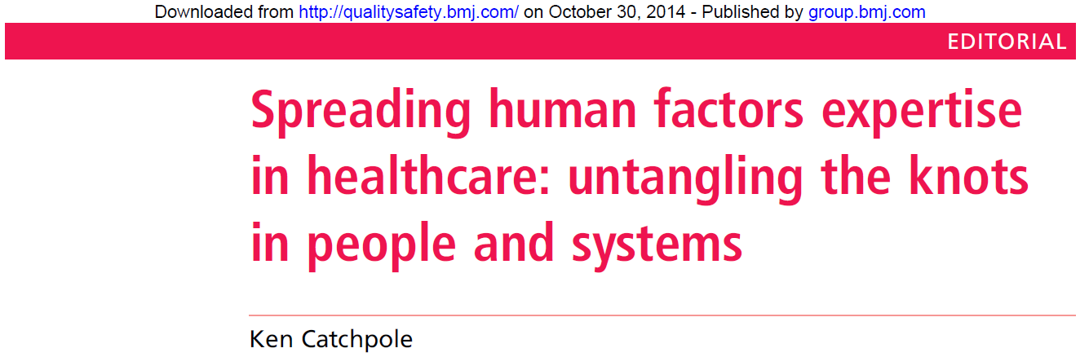

Human Factors Myths & Misunderstandings in Healthcare
Human Factors ≠ Factors of the Human
Human Factors ≠ Cause of failure
Human Factors ≠ Team Training
Human Factors ≠ Non-Technical Skills
Human Factors ≠ Crew Resource Management
Human Factors ≠ QI
Human Factors ≠ Clinical Skills
Human Factors ≠ Simulation
Notes:
Talking Points:
This slide highlights and seeks to raise awareness of examples of some of the common conflations that do the rounds in healthcare about HFE – it is more often than not conflated with non-technical skills training/crew resource management/team training – this misunderstanding arose from the way these initiatives were imported from other industries into healthcare, often via anaesthetic and surgical education
In simple terms, none of these initiatives (great though they may be) adhere to the 3 distinguishing features outlined in the Mothership slide.
Discussion Question: Optional: Ask Learners if they experiences of HFE being conflated with any of this in their own organisations? How might they address this from now on?
Activity:
Time: 2-5 minutes
Visual Cue:

Slide 35

Medical Hubris

Slide 36
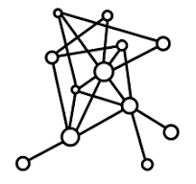
Failure to Treat Healthcare as a Highly Complex Sociotechnical System

Slide 37

Policy and Resource

Slide 38

Suitably Qualified and Experienced Professionals
[SQEPs]?

Slide 39

HF Integration in Education and Training

Slide 40

Sustaining HF Learning and Development Networks

Slide 41
Thank You Very Much!
Quick Q&A
Email: paul.bowie@nhs.scot

