Slide 1

Human Factors & Ergonomics
‘Brilliant Basics’ for Health & Social Care Teaching Faculty

Slide 2
Human Factors
What is it?

Slide 3
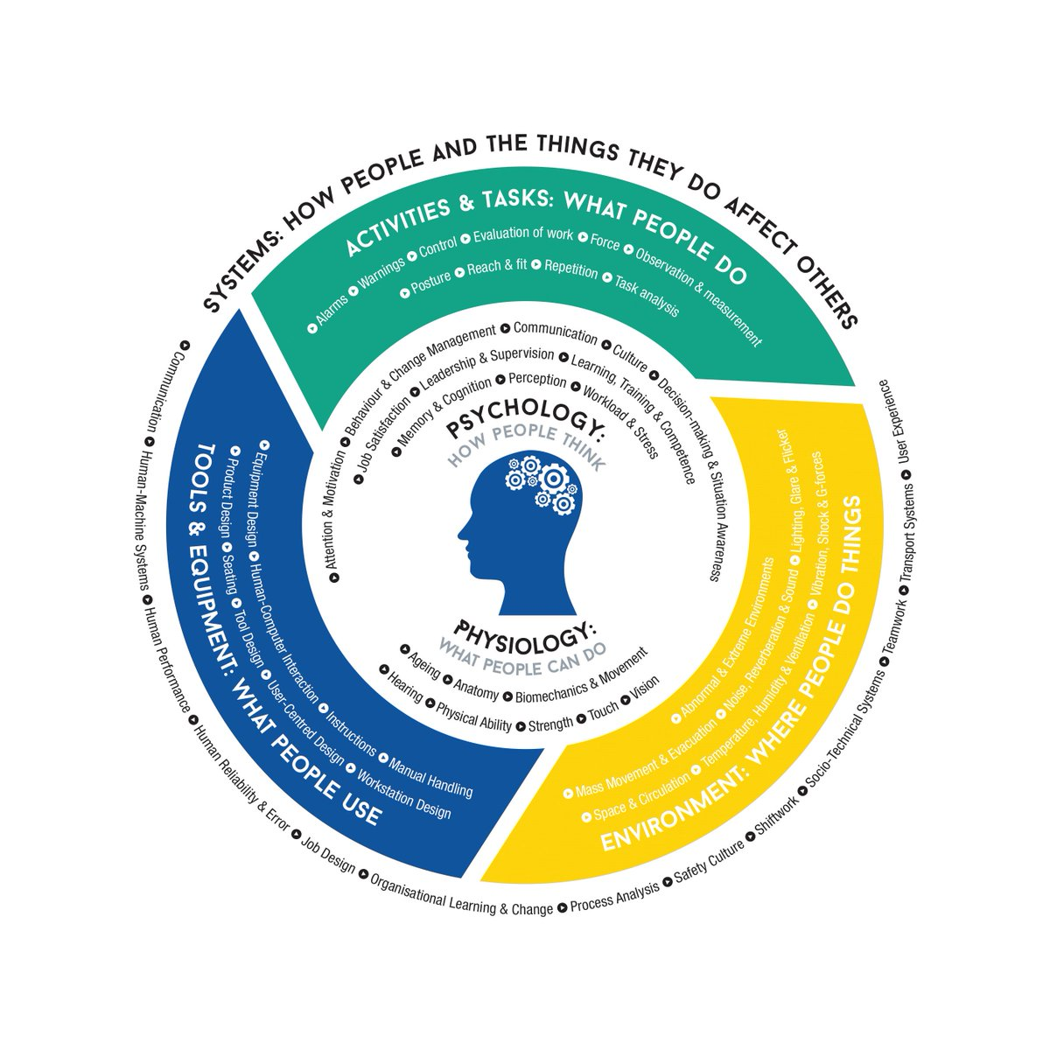
Defining Human Factors/Ergonomics (HFE)
“Ergonomics (or human factors) is…concerned with the understanding of interactions among humans and other elements of a system…in order to optimize human well-being and overall system performance...” (IEA, 2000)
In simpler terms:
Applying human factors ensures that systems, products and services are designed to make them easier, safer and more effective for people to use
Designing for people to make things easier and safer

Slide 4
Human Factors/Ergonomics Discipline…
Organisational Performance
  System safety
  Efficiency
  Effectiveness
  Reliability
  Productivity
Draws on principles derived from other disciplines e.g.
  Anatomy
  Biomechanics
  Physiology
  Anthropometrics
  Psychology
  Engineering
  Sociology
  Interaction design
  Organisational management
  User experience
Human-Centred Design of:
  Tasks
  Procedures
  Work systems
  Technology
  Products
  Services
  Workspaces
  Buildings
Human Wellbeing
  Health & Safety
  Satisfaction
  Experience
  Comfort
  Enjoyment

Slide 5
Wide ranging discipline -
Focus is on improving all aspects of Human Work e.g.
New information technology
Reducing work-related musculoskeletal disorders
Medical device design & usability
Healthcare procurement of products & services
Supporting the ageing clinical workforce
Reflecting on prevailing safety culture
New ways of working e.g. AI
Design of care environments / buildings
Design & usability of reporting systems
Wellbeing - job stress, fatigue and burnout
Safety & Improvement interventions
Learning from safety occurrences & everyday work

Slide 6
About the HFE Profession (e.g. UK/North America/rEurope)
A science, applied practice and profession
Postgraduate training level - accreditation
Registered and Chartered profession (e.g. CIEHF/HFES)
Regulated, CPD and Indemnity
“Professional appropriation” issue in healthcare
Build capacity and capability creatively – to add value

Slide 7
Accessing HF Expertise - Organisational Advice
Five Questions to Ask before Buying Human Factors Training or Consultancy
Qualification – Do they have a recognised qualification in HF/E?
Accreditation – Do they have an appropriate level of membership of an HF/E related professional organisation?
Code of Ethics – Do they abide by a code of ethical conduct from an HF/E related society or association?
Experience – Do they have experience in the HF/E work and the domain of interest?
Social recognition – Is the person recognised as an HF/E specialist by other qualified HF/E specialists?
Professional Appropriation
Shorrock, 2018

Slide 8
Who is Improving Human Work in Healthcare?
Improvement Advisor
Clinical Risk Advisor
Patient Safety Officer
Clinical Governance Manager
Organisational Development Professional
Occupational Health & Safety Professional
Clinicians, leaders, managers, scientists, ancillary, admin etc.
Human Resources
Health services researcher
Regulators & Accreditors
Implementation Scientist
Industrial / Work Psychologist
User Designer / UX Researcher
Ergonomist / Human Factors Specialist (very rare!)

Slide 9
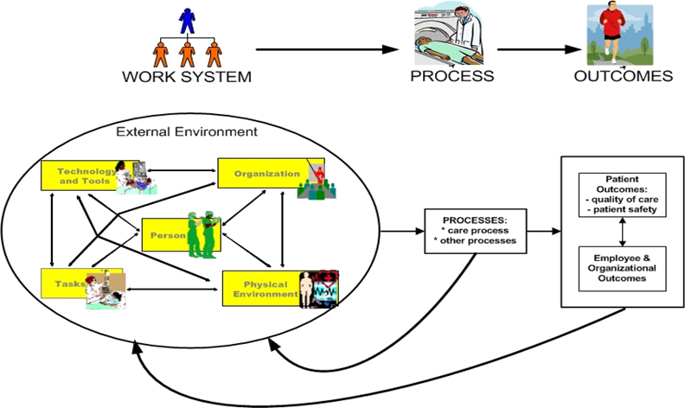
Distinguishing Features of Human Factors & Ergonomics
It ALWAYS takes a Systems Approach (holistic)
It is ALWAYS Design Driven (to take account of human characteristics, needs, capabilities and preferences)
It focuses ALWAYS on two closely related outcomes: System Performance and Human Well-being (“Twin Aims” = “Joint Optimisation”)
Design thinking, including the principles
and processes of designing for human use.

Slide 10
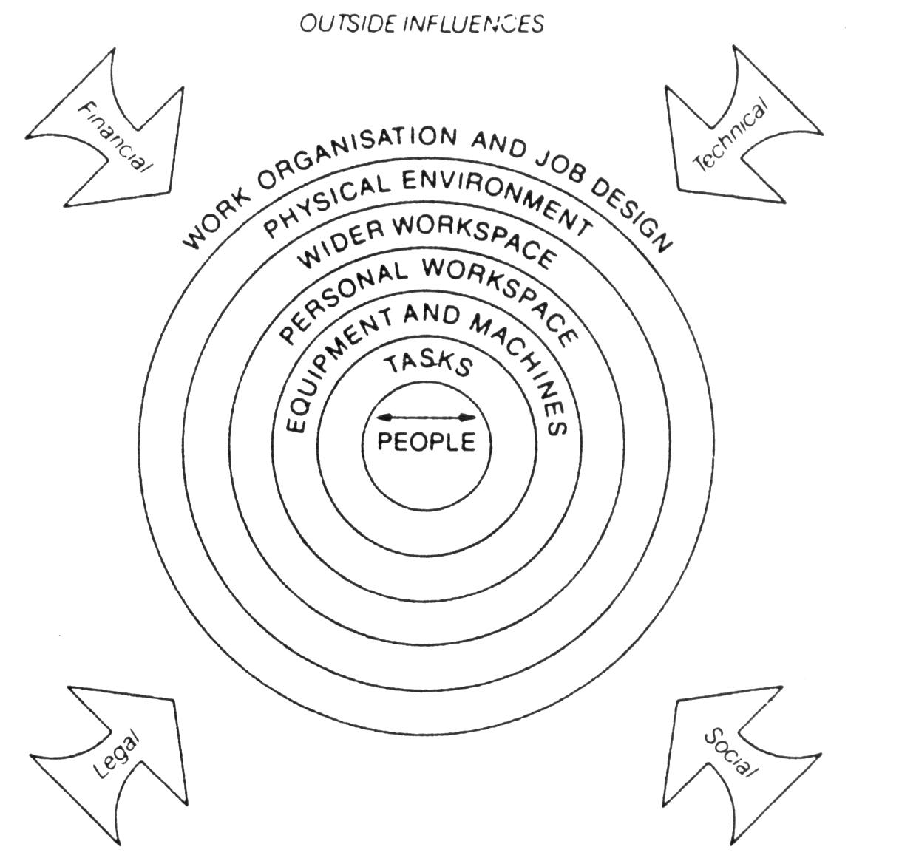
Human Factors – Sociotechnical System Models
System Engineering Initiative for Patient Safety (SEIPS) Model
(Carayon, 2006)
Wilson and Corlett, 2003

Slide 11
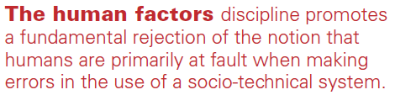
Examples of Underlying HFE Principles
Participatory Design
Systems Approach
Applying Design Knowledge
(ISO…)
Mismatches
(Identification & Understanding)
Interactions are Key
(micro, meso, macro)
Closing the Gap
(Work-as-Imagined v Work-As-Done)

Slide 12
Other High Risk Industries
Human Factors is highly established in other safety critical industries:
  Nuclear
  Maritime
  Military
  Aviation
  Rail
  Surveillance
  Offshore industries
  Energy
Aviation versus Healthcare Comparison!!!
EUROCONTROL c7500 employees (40 professionals)
UK Health Service c1.3m employees (<10 professionals)
Urgent need to build capacity & capability

Slide 13
Human Factors
What its Not!

Slide 14
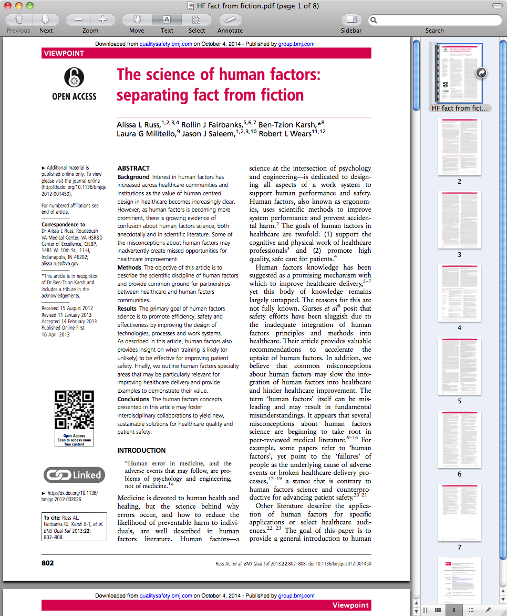
Human Factors and Ergonomics in Health Care:
Myths & Misunderstandings

Slide 15
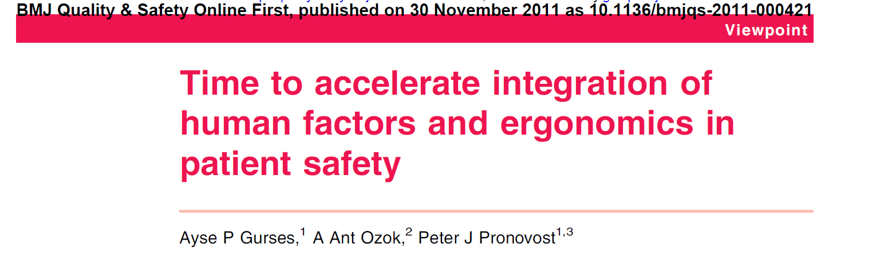
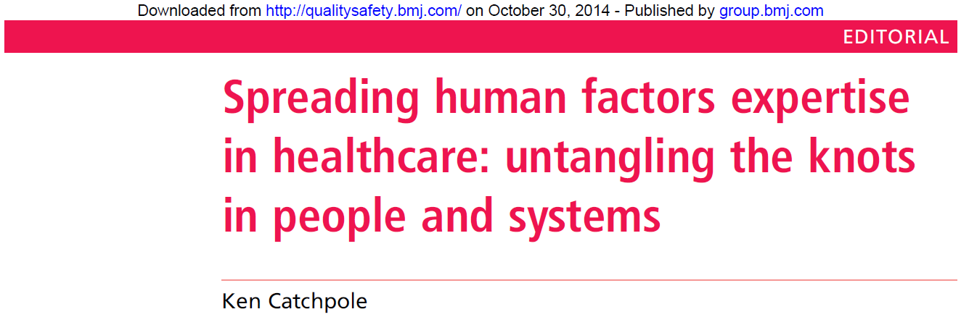
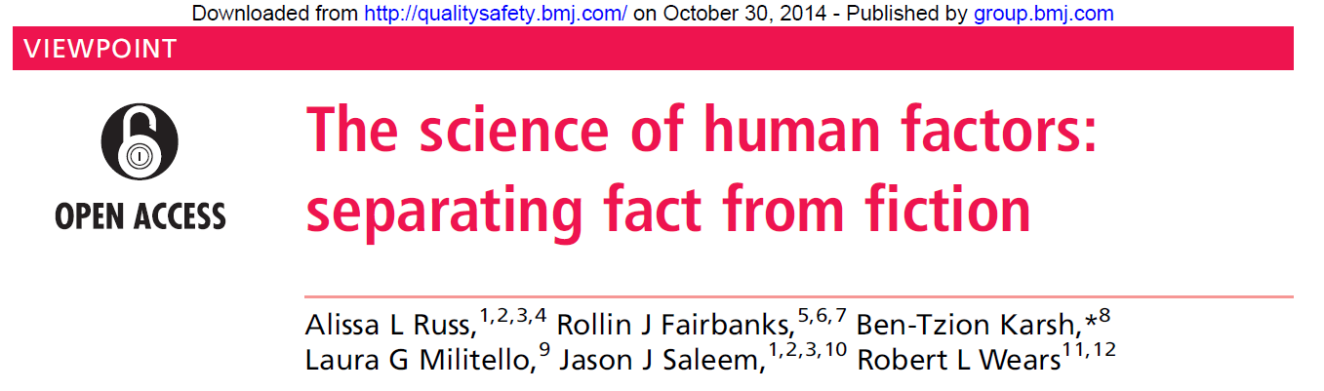
Human Factors Myths & Misunderstandings in Healthcare
Human Factors ≠ Factors of the Human
Human Factors ≠ Cause of failure
Human Factors ≠ Team Training
Human Factors ≠ Non-Technical Skills
Human Factors ≠ Crew Resource Management
Human Factors ≠ QI
Human Factors ≠ Clinical Skills
Human Factors ≠ Simulation

Slide 16
Healthcare Human Factors – Five Fallacies
Human Factors addresses workplace problems by teaching people to modify their behaviours X
Human Factors is about eliminating ‘human error’ X
Human Factors is focused only on individuals X
Human Factors is just ‘common sense’ X
Human Factors consists of a limited set of principles that can be learnt during brief training X

Slide 17

‘Stubborn Myths’ and ‘Hard Truths’
“Patient Safety has been described as... dead as a reform effort’ and that the ‘patient safety movement itself has gotten things wrong. Its understandings … of concepts such as safety, harm, risks and hazards are incomplete and simplistic and, as a result, its work has been grounded in assumptions and generalisations that are either wrong or lacking in context’.
Most healthcare
  publications (academic, policy and grey literature)
  Education & training curricula
Misunderstand and misrepresent Human Factors/Safety Science principles and methods
Wears & Sutcliffe (2020)

Slide 18
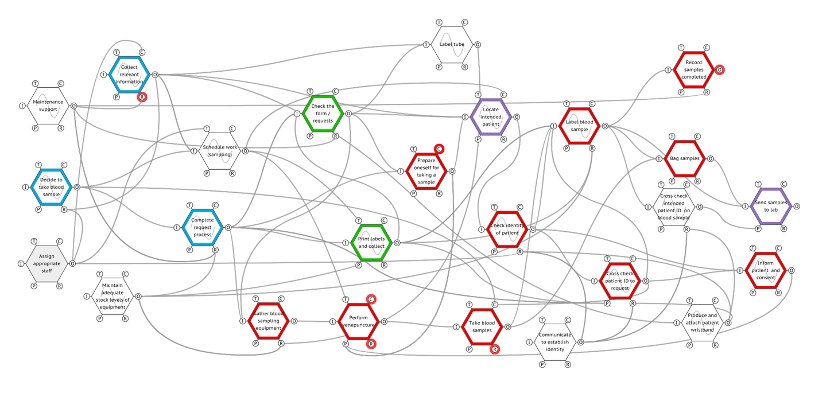
The ‘Simple’ Act of Taking Blood in Healthcare
STEP 1
Complex Interacting
Simple Linear
STEP 2
STEP 3
STEP 4
STEP 5
SUCCESS!
Pickup L, Hollnagel E, Bowie P et al. Blood sampling - Two sides to the story. Applied Ergonomics. 59. 2017; 234–242

Slide 19
A Blueprint for Building HF Capacity & Capability?
HF Capability
Teaching Faculty
Undergraduate Students
Clinical Skills & Simulation
Postgraduate Trainees
Board Members
Public Servants
Politicians
Executive Teams
Risk, Safety & Improvement Advisors
National Initiatives
Regulators
Modern Apprentice

Slide 20
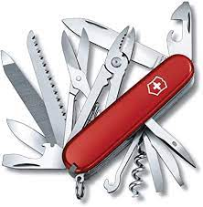
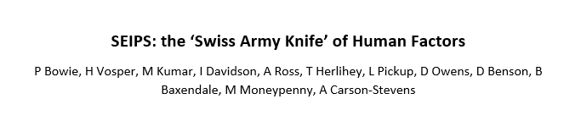
SEIPS: Multi-Purpose System Analysis & Design Tool
Multi-Functional Tool e.g.
  Incident reporting and data collection
  Process mapping and systems thinking
  Care system designs and redesigns
  Design of simulation scenarios
  Hazard identification, dynamic risk assessment & control
  Team-based learning from incidents, complaints and everyday work
  Safety and complaints investigation/learning
  Considering Workforce wellbeing issues
  Teaching fundamentals of the HF Systems Approach
  Designing standard operating procedures
  Problem solving everyday hassles and irritations

Slide 21
Systems Engineering Initiative for Patient Safety (SEIPS) Worksheet
Work System
Care Process
Outcomes
External Influences
Care and Other Work Processes
Wanted / Unwanted
Outcomes
System Performance:
Human Wellbeing:
Technology and Tools
Organisation of Work
Person Factors
Job Tasks
Physical Environment

Slide 22
SEIPS Explained
Examples of Performance Influencing Factors (PIFs)
Outcomes
SEIPS is the Safety Engineering Initiative for Patient Safety.
It is based on a Human Factors systems approach to understanding care systems, processes and outcomes to inform better design and improvement.
SEIPS can be used by anyone as a general systems analysis and problem-solving tool e.g. incident investigation; hazard identification; incident reporting & data collection; simulation design; protocol & checklist development; research design and data analysis..
Person Factors
e.g. Physical, psychological capabilities, limitations and impacts (frustration, stress, fatigue, burnout, musculoskeletal, satisfaction, enjoyment, experiences, job control); personality or social issues; cognitive ; competence, skills, knowledge, attitudes; risk perception; training issues; personal needs and preferences; psychological safety; performance variability; personal goals; adaptation to work conditions.
Care team e.g. roles, support, communication, collaboration, supervision, management, leadership
Patient/client e.g. complexity of clinical condition, physical, social, psychological, relationship factors
Others e.g. families and carers, and other health and social services colleagues
Task Factors
Specific actions within larger work processes, includes task attributes such as:
level of task difficulty /complexity;
time taken;
hazardous nature;
variety of tasks;
sequencing of tasks
workload, time pressure, cognitive load,
Organisation of Work Factors
e.g. Structures external to a person (but often put in place by people) that organise time, space, resources, and activity.
Within institutions:
Work schedules/staffing
Workload assignment
Management and incentive systems
Organisational / safety culture (values, commitment, transparency)
Training
Policies/procedures
Resource availability and recruitment
In other settings:
Communication
Infrastructure
Living arrangements
Family roles and responsibilities
Work and life schedules
Financial and health-related resources
Outcomes –
System Performance
e.g. Safety; productivity; resilience; efficiency; effectiveness; care quality
Physical Environment
e.g. Layout; noise; lighting; vibration; temperature; humidity and air quality; design of immediate workspace or physical environment layout; location; size; clutter; cleanliness; standardisation, aesthetics; crowding
Outcomes –
Human Wellbeing
e.g. Health and safety; patient satisfaction and experience; enjoyment; staff turnover; staff welfare; job satisfaction
Guiding Step
As a team, use the worksheet as a prompt to highlight the system-wide factors that contribute to the issue at hand
Seek to understand how these factors influence processes and interact to produce outcomes (wanted or unwanted)
Link this new knowledge to making improvement recommendations
External Influences
e.g. Societal, government, cultural, accreditation and regulatory influences e.g. funding, national policies and targets, professional bodies, regulatory demands, legislation and legal influences, other risks and influences
Tools & Technology
e.g. design interaction and device usability issues; familiarity; positioning, accessibility; availability; access; mobility; operational /calibrated /maintained; device usability; various IT design issues.

Slide 23

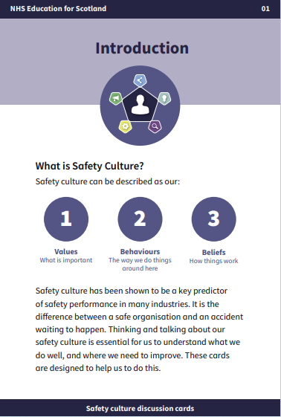
Safety Culture Discussion Cards

Slide 24
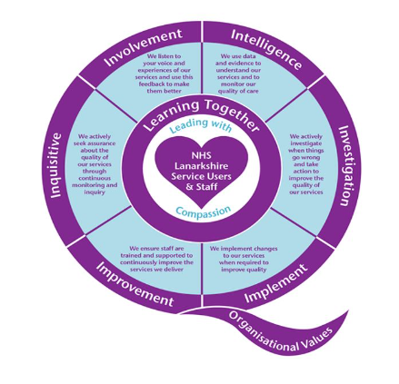
Safety Culture Cards
Staff feedback
Many thanks to Karon Cormack
Director of Quality
NHS Lanarkshire

Slide 25
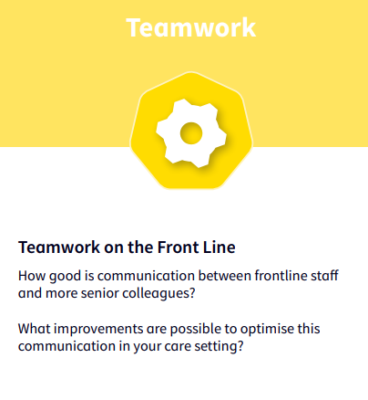
Lets hear from our colleagues…
Peter McCrossan Director of Allied Health Professionals NHS Lanarkshire
Peter shares his experience of using the safety culture cards at the North Health and Social Care Partnership senior leadership team meeting
Key Points:
You can use the cards in a variety of different ways
Peter facilitated a 20 minute group discussion
Set ‘ground rules’
Good discussion with staff being open and honest
Actions captured and an action plan developed
“Really invaluable tool in helping teams and colleagues reflect and identify areas for improvement”
“Safety culture matters; it directly impacts on the quality and safety of care”
Links to video clip:
https://vimeo.com/823322014
https://youtu.be/54tytXTbXVA
Notes:
The Safety culture cards will help us think and talk about our Safety Culture with our teams, specialties, disciplines, directorates and should focus on elements that will help you and your colleagues think and talk about Safety culture.
You can use them in any way that will help you.
As an organisation one of the ways that can help teams use these is to discuss ‘Safety Moments’. The process for this is in the table below:

Slide 26
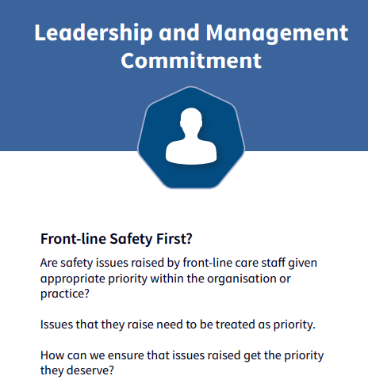
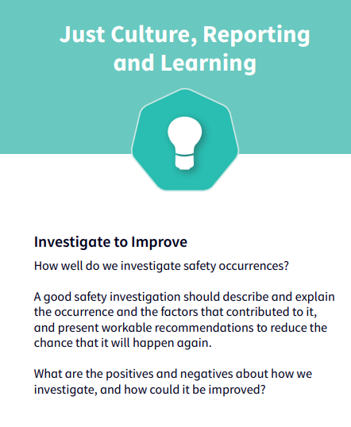
Lets hear from our colleagues…
Stewart Marshall and Elise Palmer Service Manager, South HSCP and Improvement Advisor
Stewart shares his experience of when he uses the cards and how he uses them with the Team Leaders in the locality he manages
Key Points:
The team selected ‘option 2’ Safety moments for using the cards (Discuss just one issue for 10-15 mins)
Team used the ‘ discussion’ template – interactive way to generate ideas and highlight areas for improvement
The team used the ‘You said, we did’ template to take forward agreed actions
The cards are a great way to promote psychological safety. Staff feel listened to and valued
Really positive experience of using the cards as a way to stimulate conversation
Links to video clip:
https://vimeo.com/822660732
https://youtu.be/xExcMoZSoDE
Using the safety culture cards is a great way to have an interactive discussion around what we could do differently and consider ways to improve and promote psychological safety
Notes:
The Safety culture cards will help us think and talk about our Safety Culture with our teams, specialties, disciplines, directorates and should focus on elements that will help you and your colleagues think and talk about Safety culture.
You can use them in any way that will help you.
As an organisation one of the ways that can help teams use these is to discuss ‘Safety Moments’. The process for this is in the table below:

Slide 27
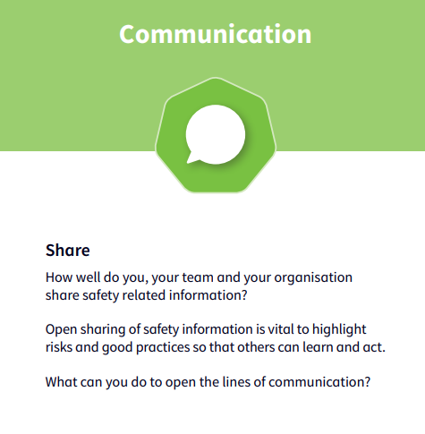
Lets hear from our colleagues…
Trudi Marshall Nurse Director North Health and Social Care Partnership
Trudi shares her experience, approach and benefits of using the cards at strategic leadership team meetings in the partnership
Key Points:
Integrated focus on safety across the partnership
Agreed at start of each meeting to take 5 minutes to discuss a card
Group would select a card to share their experiences
Staff picked a card that was a ‘burning topic’ for them
“Positive experience of using the cards overall”
“Led to discussions around the ‘elephant in the room’ and staff found this really beneficial”
Links to video clip:
https://vimeo.com/824025503
https://youtu.be/FXX4xJyXW90
Notes:
The Safety culture cards will help us think and talk about our Safety Culture with our teams, specialties, disciplines, directorates and should focus on elements that will help you and your colleagues think and talk about Safety culture.
You can use them in any way that will help you.
As an organisation one of the ways that can help teams use these is to discuss ‘Safety Moments’. The process for this is in the table below:

Slide 28
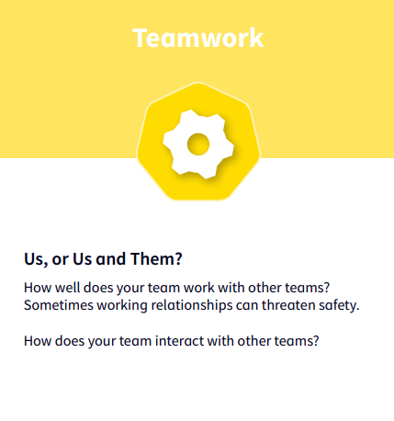
Lets hear from our colleagues…
Nicola Kelly and Craig Eden Senior Nurse, North HSCP and Improvement Advisor
Nicola describes her experience of using the cards in the North partnership District Nurses professional forum
Key Points:
Used the cards to identify areas working well and potential areas for improvement
The team used the ‘discussion’ template as a visual aid the group found very helpful.
The strength of peer support and importance of encourage and promoting this across the teams
Celebrating what we do well and turning challenges into opportunities
The staff felt it was a safe space to voice their concerns in an open environment away from their workplace
…their desire and will to improve team working for their patients was very evident in the discussions
Links to video clip:
https://vimeo.com/826156035
https://youtu.be/oWLy97bXJZ4
The group valued the shared learning using the safety culture cards can provide
Notes:
The Safety culture cards will help us think and talk about our Safety Culture with our teams, specialties, disciplines, directorates and should focus on elements that will help you and your colleagues think and talk about Safety culture.
You can use them in any way that will help you.
As an organisation one of the ways that can help teams use these is to discuss ‘Safety Moments’. The process for this is in the table below:

Slide 29
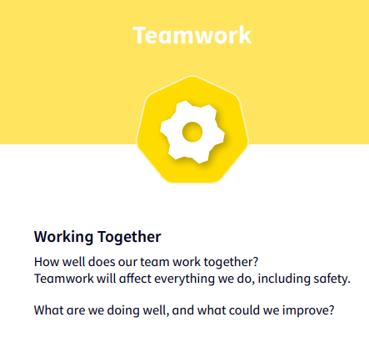
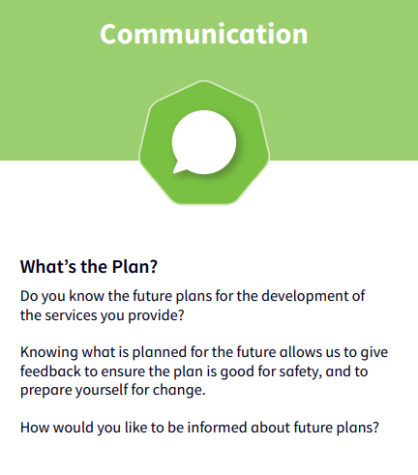

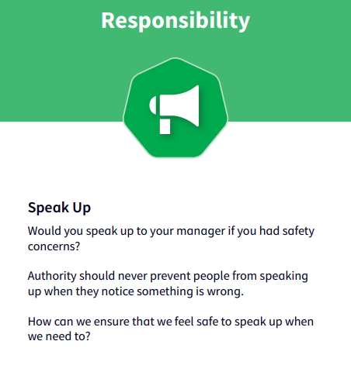
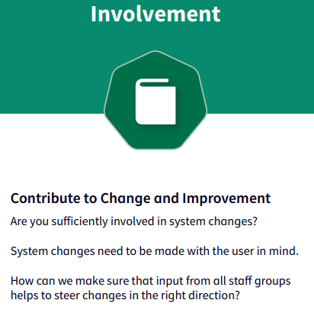
Lets hear from our colleagues…
Karon Cormack Director of Quality NHS Lanarkshire
Karon provides feedback on the use of the cards throughout 2022 at the Corporate Management Team (CMT) meetings
Key Points:
The cards are adaptable
They can be used in a small group
Record your discussions on LanQIP:
  Discussion date
  Cards discussed
  Agreed actions
Links to video clip:
https://vimeo.com/822673314
https://youtu.be/3Dgn4xahzXA
The cards can help take a conversation in a direction you might not have otherwise thought of…
Notes:
The Safety culture cards will help us think and talk about our Safety Culture with our teams, specialties, disciplines, directorates and should focus on elements that will help you and your colleagues think and talk about Safety culture.
You can use them in any way that will help you.
As an organisation one of the ways that can help teams use these is to discuss ‘Safety Moments’. The process for this is in the table below:

Slide 30

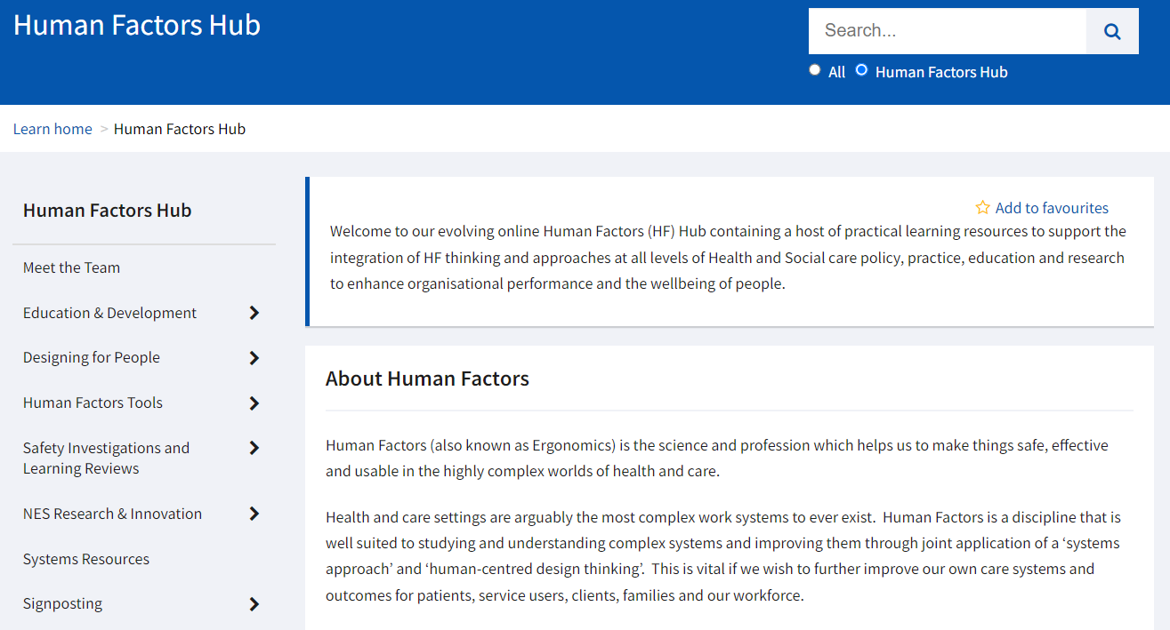
e-Learning
NES Human Factors Hub

Slide 31
Thank You Very Much!
Q
A

